Slide 1
Introductory Level Apprentice Rep Training
name of trainer
associate trainer | sparqs

Slide 2
Safeguarding
Attendees at our training are expected to undertake responsibilities in a way that is respectful of others, ensuring that the training is accessible for all to participate. We’re committed to making an environment for attendees that is free from discrimination, harassment and prejudice.

Slide 3
sparqs
student partnerships in quality scotland.
Our role is to ensure that students can make a positive difference to learning and teaching.
Around 4000 reps trained each academic year.
Funded by the Scottish Funding Council since 2003.
Supporting students on different learner journeys.

Slide 4
Learning outcomes for today
Develop your understanding of the apprentice rep role and describe the work involved in being an apprentice rep.
Discuss the Apprentice Learning Experience (ALE) and explore how you can use it to assist you in your role as an apprentice rep.
Develop some of the skills you will use as an apprentice rep.
Access support to you as a rep.
Notes:
4

Slide 5
Exercise 1 - Group introductions
Speaking for about a minute, let your fellow reps know:
Who you are.
What apprenticeship you are doing and something you like about it.
Why you wanted to be a rep, and how you came to be a rep.
What you would like to get out of today.

Slide 6
Exercise 2 - Your rep role
What do you think the purpose of the apprentice rep is?
What do you think some of the tasks will be?
What skills do you think you will need and develop as a rep?
How do you think being a rep will benefit you?
Notes:
6
Flip chart exercise probably best to do this as a whole group - trainer writes up on flip chart as ideas come from the CRs under the headings - purpose, tasks, skills, benefits to you

Slide 7
Purpose of a rep
To continuously improve the apprentice learning experience in partnership with the employer, the institution/training provider and, where appropriate, the students’ association by helping create solutions to problems.
To represent your fellow apprentices’ views and opinions on all matters relating to the learning and teaching aspect of their apprenticeship.
To provide both positive and negative feedback.
To act as a communication channel between apprentices and their learning provider.
Notes:
This slide is just reinforcement for what they have already covered on the flip chart in more general terms

Slide 8
Rep tasks
Introduce yourself to your group.
Gather apprentice opinion.
Provide feedback to learning providers.
Present apprentice views at meetings.
Attend meetings.
Speak to people outside of meetings.
Develop solutions to issues.
Pass issues onto students’ association where appropriate.
Contribute to institutional activities.
Pass on information to the employer where appropriate.
Notes:
8
As is this slide

Slide 9
Rep skills
Organisation.
Report writing.
Diplomacy.
Negotiation.
Research.
Time management / prioritisation.
Communication.
Listening.
Networking.
Relationship building.
Reflection.
Presentation.
Notes:
And this slide

Slide 10
Benefits of being a rep
Learn new skills.
Looks good on your CV.
Networking opportunities.
Background for future representational roles.
Good experience for future employment.
Can be validated on student transcripts for further/higher education.
Make a difference.
Notes:
And this final one

Slide 11
Why is representation important?
Apprentice
views
Dialogue
with teaching staff/training providers
Improved learning
experience
You are an expert on your learning experience

Slide 12
Exercise 3 - Your apprenticeship
In your small groups, discuss the following questions:
What do you most like about your apprenticeship?
What would you like to change or improve about your apprenticeship?
Write this down on a post-it note for use later!
Notes:
12

Slide 13
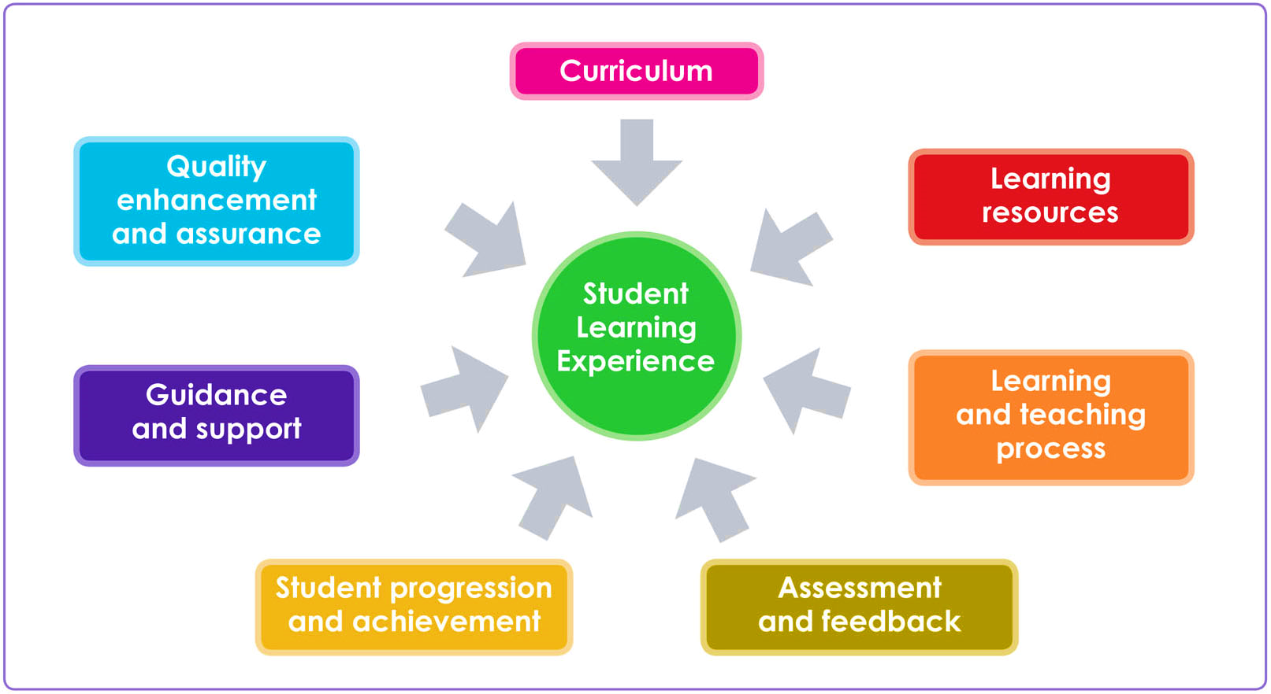
The Apprentice Learning Experience
Apprentice Learning Experience
Progression and achievement
Notes:
Introduce this by asking the whole group to come up with ideas about they understand by all of the headings on the SLE – Curriculum, Learning Resources, Learning and Teaching Process etc.

Slide 14
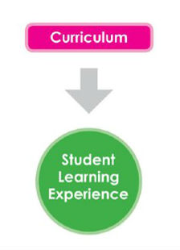
Curriculum
This describes the content of the taught section of the apprenticeship and how that is structured.
Are the learning objectives clearly stated and being followed?
Does the curriculum being taught match your expectations from the information provided about the apprenticeship?
Can you see how the taught part of your course relates to the reality of the workplace?
Apprentice Learning Experience

Slide 15
Learning Resources
Staff, equipment, tools, text books, manuals and appropriate clothing.
Workshops, classrooms, labs, lecture theatres, IT, VLE resources.
Does the equipment in college adequately prepare you for work-based application?
Apprentice Learning Experience

Slide 16
Learning and Teaching Process
How apprentices are taught and how they learn.
The range of teaching methods that are used.
Is it the right method for the type of apprenticeship?
Is it accessible?
Do your teachers and tutors draw on real life experience?
Apprentice Learning Experience
Notes:
The range of teaching methods that are used? Lectures, tutorials, practical work, labs, group work.
Is it the right method for the kind of course? Is there a good balance of theory work and practical activity?
Is it accessible?

Slide 17
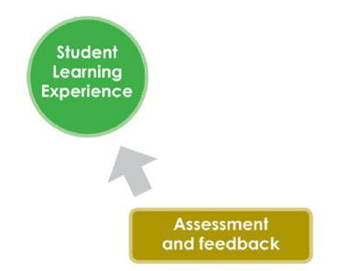
Assessment and Feedback
Are assessments spaced out well?
Are they the right kind of assessments for the type of module/unit/course?
What kind of feedback is given? Is it of good enough quality?
Does feedback help you see where and how you need to improve?
Are the assessments work-based or college-based and how do they relate?
Apprentice Learning Experience

Slide 18
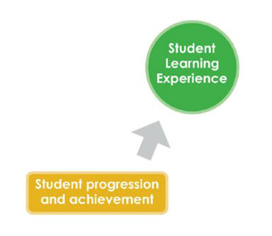
Progression and Achievement
Are you able to progress easily from one module/unit to the next?
Are you able to evaluate your own personal progress throughout the apprenticeship?
Are further progression opportunities and pathways made clear to you?
If your apprenticeship has an opportunity of employment at the end of it, is that route clear and transparent for all?
Apprentice Learning Experience
Progression and achievement

Slide 19
Guidance and Support
How much support are you receiving with the academic aspect of your apprenticeship?
If you are struggling, where do you go for advice?
Are you given clear guidance on what is expected of you as an apprentice?
Do you have identified guidance for the taught part of your apprenticeship?
Is it made clear to you within college and employer settings where to get support on a range of issues?
Is it made clear to you which policies apply to you as a student and you as an employee?
Are you aware of the avenues of support that relate to your student experience and your employee experience, e.g. student support, HR policy and Trade Unions?
Apprentice Learning Experience

Slide 20
Quality Enhancement and Assurance
Do you feel that staff and the training providers are receptive to apprentice concerns and suggestions?
Do you feel that you and your fellow apprentices’ opinions are listened to?
What improvements have been made to your apprenticeship during your time of learning?
Are you confident issues raised with the college are passed to the employer and vice versa?
Apprentice Learning Experience

Slide 21
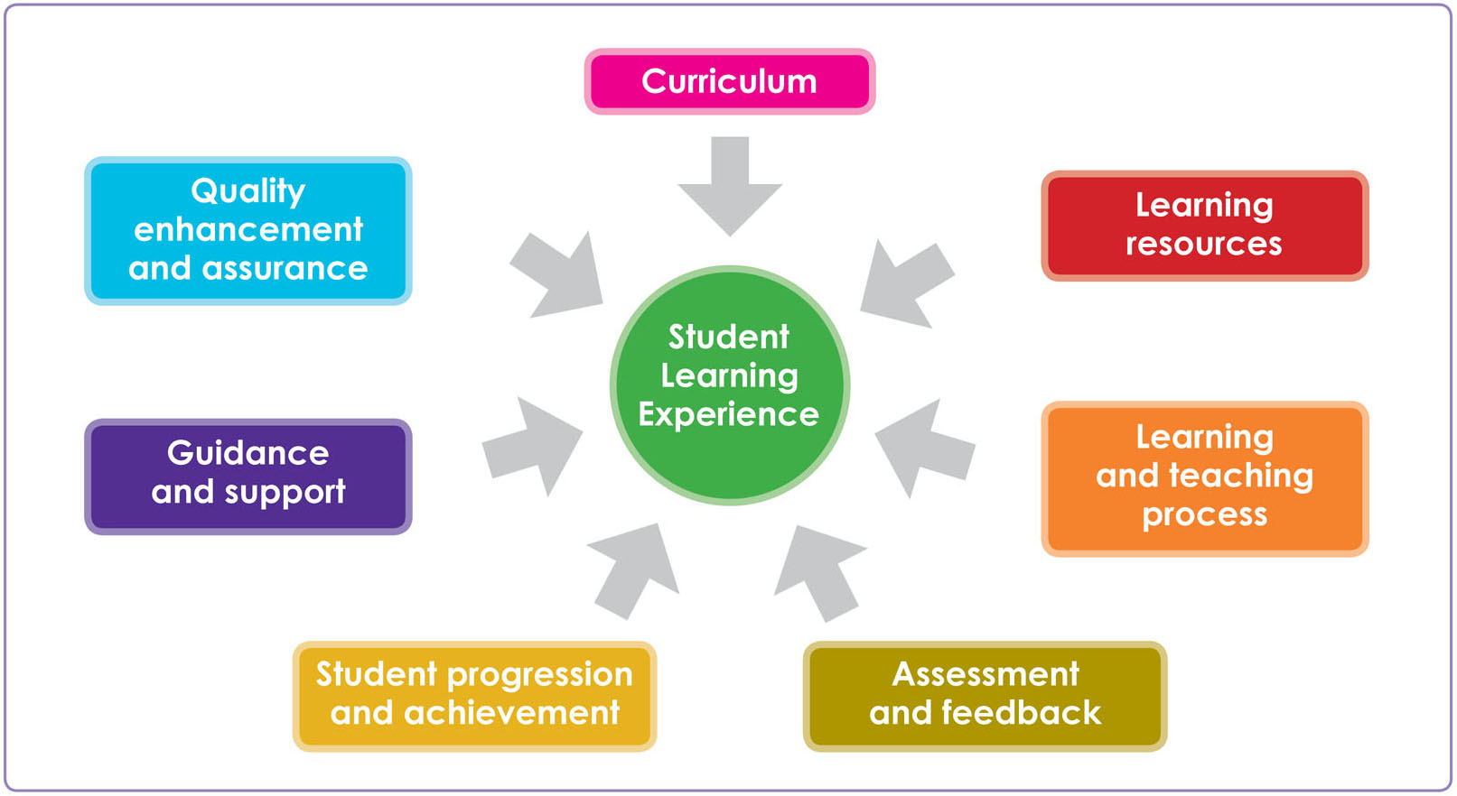
Exercise 4 – using the ALE
Take the post-it note which contains the element of your apprenticeship that you would like to improve and stick it on the Apprentice Learning Experience Diagram on the heading that you think it best fits.
Apprentice Learning Experience
Progression and achievement
Notes:
This exercise should enable you to have a short discussion on the SLE. Have they placed the improvement suggestions on the right part of the SLE? Does their example fit the SLE at all or should it be dealt with by someone else?

Slide 22
Short break

Slide 23
The Rep Cycle
Feedback
(to fellow apprentices)
Identify the issue
(by gathering apprentice opinion)
Develop &
implement
the solution (or at least try to)
Notes:
Recap slide – we showed it before the break – the slides have expanded language

Slide 24
Apprentice rep activities
It involves several things:
Identifying issues.
Researching how the issues affect apprentices.
Presenting your case to the relevant meeting or person.
Working with them to solve the issue if you can.
Feeding back to apprentices about what’s changed.
Notes:
24
This is just an alternative way of expressing the previous slide – for re-inforcement and for people who do not relate well to diagrams.

Slide 25
Exercise 5 – Gathering apprentice opinion
Think back to exercise 3 and look at the answers given about what you liked most about your apprenticeship and what you would like to change.
In your groups write down how you would find out from your fellow apprentices about whether or not they agree/disagree with these opinions.

Slide 26
Gathering apprentice opinion
Discussion in groups
Emails.
Surveys.
Post it notes in tutorials/workshops.
Comment boxes.
Online spaces:
Facebook.
Twitter.
Virtual Learning Environments (VLE) e.g. Moodle/Blackboard.
Are there any internal mechanisms used by the employer for gathering/feeding back information?
Notes:
Maybe a brief discussion with the whole group on the advantages and disadvantages of each approach.

Slide 27
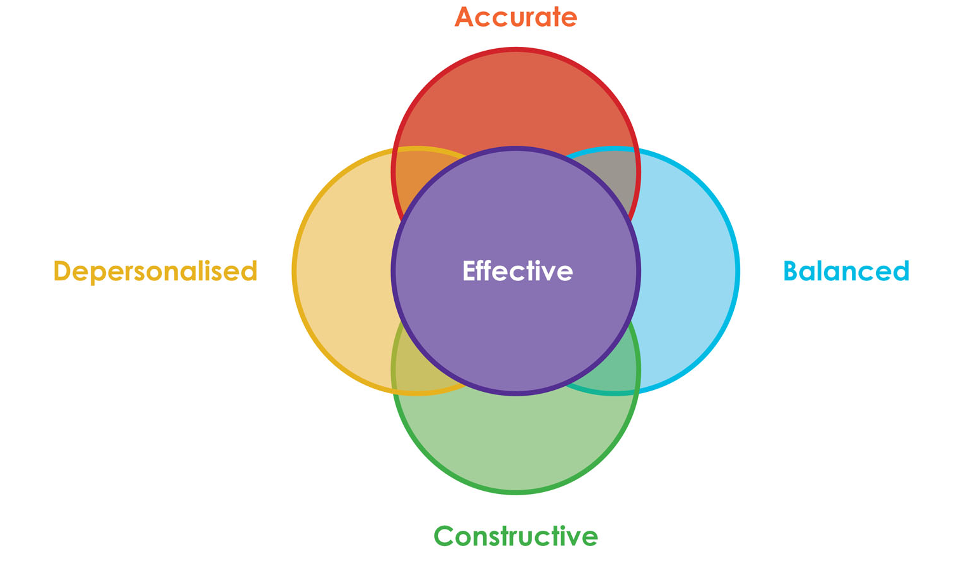
The A,B,C,D of Effective Feedback

Slide 28
A is for Accuracy
I have spoken to some of my apprentice group and we think that there is not enough practical work on the x module.
I have had a discussion with my apprentice group and we agreed by show of hands that 18/21 feel that there is not enough practical work on the x module.

Slide 29
B is for Balanced
The whole module is really not well put together and the assessments don’t fit well with the teaching.
The theory elements of the module are taught well, are interesting and understandable to the majority (17/20) of the apprentices, but the same number feel that it would be helpful to have more practical work to back up the theory. Practical assessments would also help us feel confident that we can perform the tasks well.

Slide 30
C is for Constructive
As a group we never know what we are supposed to be doing from week to week in our x module classes.
The apprentices are keen to have a plan of work and assessments given to us at the beginning of each block in our x module classes.

Slide 31
D is for Depersonalised
After discussion with the group we want to tell you that Mr Smith is a terrible tutor/instructor/lecturer/manager who never gives assessments back on time.
After discussion with the group we want to say that the return of assessments in our x module classes is always too late to enable us to learn from our mistakes for the next assessment.
Notes:
This leads us to say that the best way to give feedback is using an ABCDE model.

Slide 32
Exercise 6 - Developing solutions
Let’s look at an example from exercise 3.
How would we tackle this to try and come up with a solution which would benefit the group?
What role are you playing and what are the pros and cons of each approach?
- Customer.
- Advocate.
- Lobbyist.
- Campaigner.
- Partner.
You need to think about:
How do we find out what the group think?
Where will we take our issue and suggestions?
How will we word it, remember ABCD?
How would we go about getting the solution implemented?
What is our timescale for the implementation?
Notes:
32

Slide 33
Making change happen
Opportunity Attendance Engagement

Slide 34
Exercise 7 - Attending meetings
Think about what you would do:
Before you to go to the meeting?
During the meeting?
After the meeting?
Notes:
34
This is a whole group flip chart exercise. Put up 3 flipcharts or the equivalent with before, during and after and write up suggestions from the group. This could also be done on a laptop, projecting onto the screen if you wish.

Slide 35
Before a meeting
Where and when is the meeting going to take place?
Find out what your fellow apprentices think about their learning experience.
Is there anything you want to put on the agenda? Get in touch with the Chair/Secretary.
Read any of the papers that have been sent round, including the previous meeting’s minutes.
Speak to other apprentice reps and in a college or university setting you can speak to other course reps and the students’ association.
Notes:
The following 3 slides are just reinforcement hopefully they will have shouted out most of these!

Slide 36
During a meeting
Always be on time, if you are going to be late let the Chair/Secretary know before the meeting.
Be prepared to take notes if necessary.
Remember the A, B, C and D of effective feedback.
Ask questions if you do not understand anything.
Support other reps in the meeting.

Slide 37
After a meeting
Report back to your fellow apprentices.
Check the minutes.
Do anything you have been asked to do.
Follow up any areas of concern.
Did you achieve what you wanted to achieve? If not what are you going to do about it?

Slide 38
Closing the loop
Don’t forget to
Feed back
what you have achieved!!
Feedback
Identify
the issue
Develop &
implement
the solution

Slide 39
Closing the loop
Report back directly to the group.
Emails.
Face to face chats.
Surveys.
Online spaces:
Facebook.
Twitter.
Virtual Learning Environments.

Slide 40
Support available to you
National Society of Apprentices Scotland via http://nsoascotland.co.uk/
Online training resources are available via www.sparqs.ac.uk
NUS Scotland, the national student representative body, can support you. Visit www.nus.org.uk for more information.
Students’ Associations.
Trade Unions/Employer Engagement Schemes.

Slide 41
Your future rep career
Online training resources are available via www.sparqs.ac.uk
If you’re interested in becoming a sparqs Associate Trainer, recruitment takes place around February/March each year.
For further info about any of these opportunities, contact us at admin@sparqs.ac.uk
Notes:
41

Slide 42
Learning outcomes for today
Reflecting on today’s training, have you…
Explored your understanding of your role as an apprentice rep?
Discussed the Apprentice Learning Experience and explored how you can use it to improve your group’s collective experience?
Developed some of the skills you will use as an apprentice rep?
Developed knowledge on how to access support available to reps?
Notes:
42

Slide 43
Thank you for attending Introductory Level Apprentice Rep Training! Please fill in your evaluation forms and hand them in.
name of trainer (email address)
associate trainer | sparqs
Notes:
43

